Slide 1


LA-CoNGA physics a case study for open science education collaboration between Latin America and Europe
XIV Latin American Symposium on High Energy Physics
Quito 11 – 14 – 2022
Dennis Cazar Ramírez
Departamento de Electrónica
Universidad san Francisco de Quito USFQ
On behalf of LA-CoNGA physics consortium

Slide 2
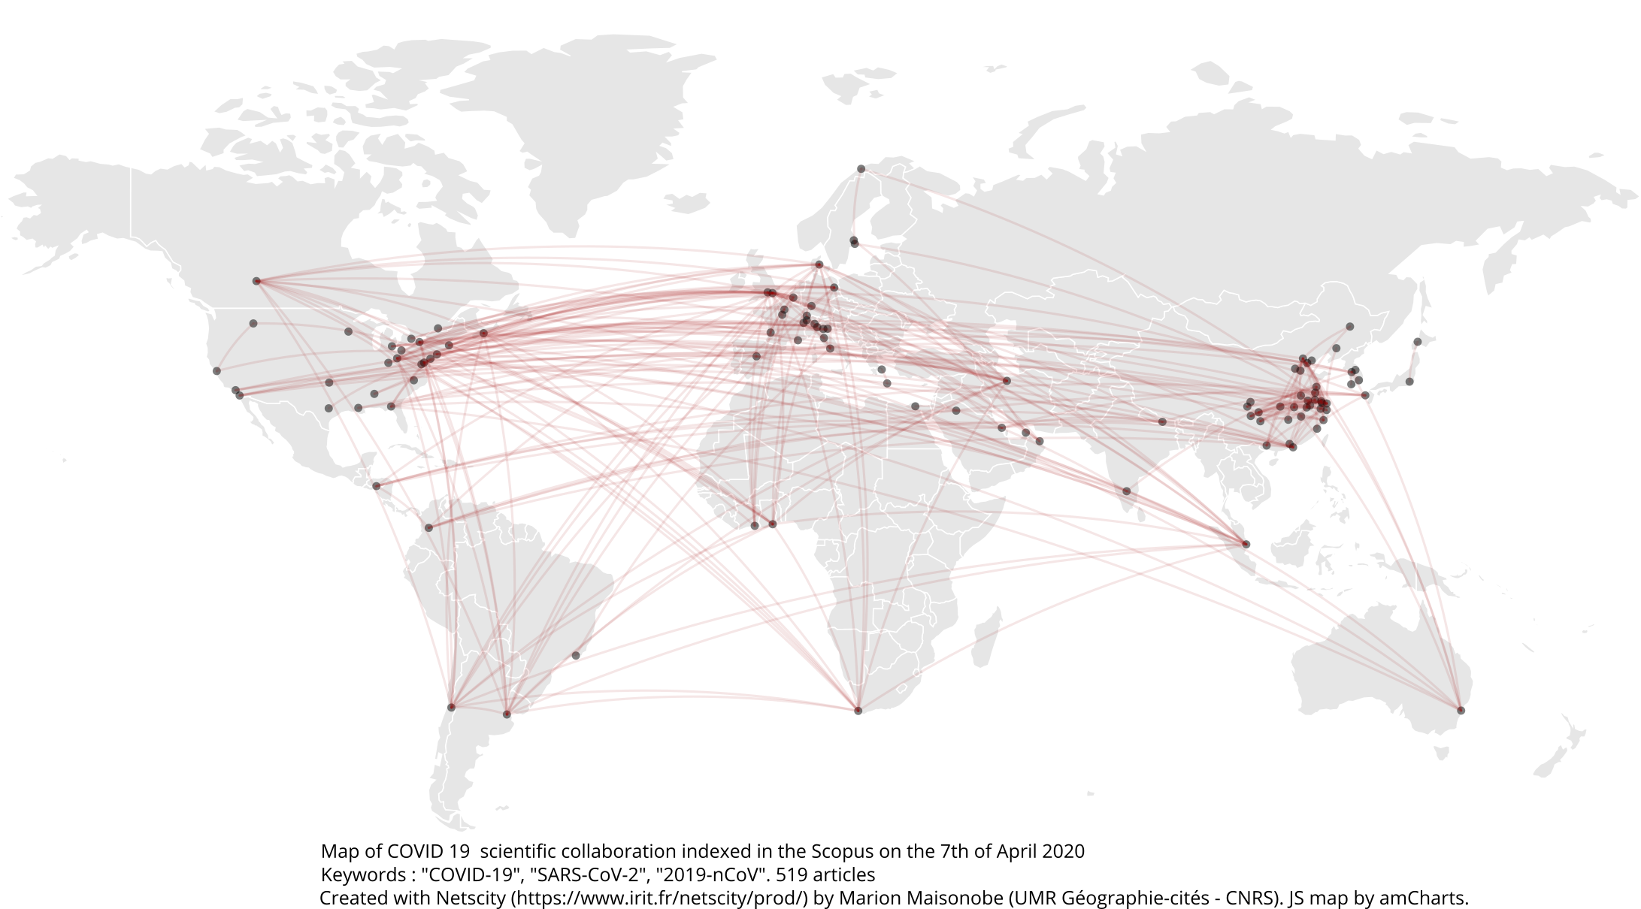
Scientific collaboration and education at a global scale
Science and higher education
globally distributed,
collaborative and
multidisciplinary
University-research-society link
knowledge generation,
application and transfer
Virtual Research and
Learning Networks
play a key role
A network where data, software tools,
research facilities, teaching and
information resources
are seamlessly shared
2

Slide 3




The importance of virtual research and learning networks
Internationalization
collaborative international environment
Accessibility
Modernization
open educational resources,
connectivity, acquisition
of digital skills, and
use/development of new
learning methods
Each institution/group
might not have
all the resources/staff
Sánchez, A., and Atlas Collaboration. "The CEVALE2VE case.” PoS ICHEP2016 (2016) 322
Caicedo, M., et al. "Virtual research and learning communities in Latin America: The CEVALE2VE case." Interciencia 42.11 (2017): 733-738
Peña-Rodríguez, J., & Núñez, L. A.. “LA-CoNGA physics: an Open Science Collaboration in Advanced Physics between Latin-America and Europe”. arXiv:2201.02256.

Slide 4
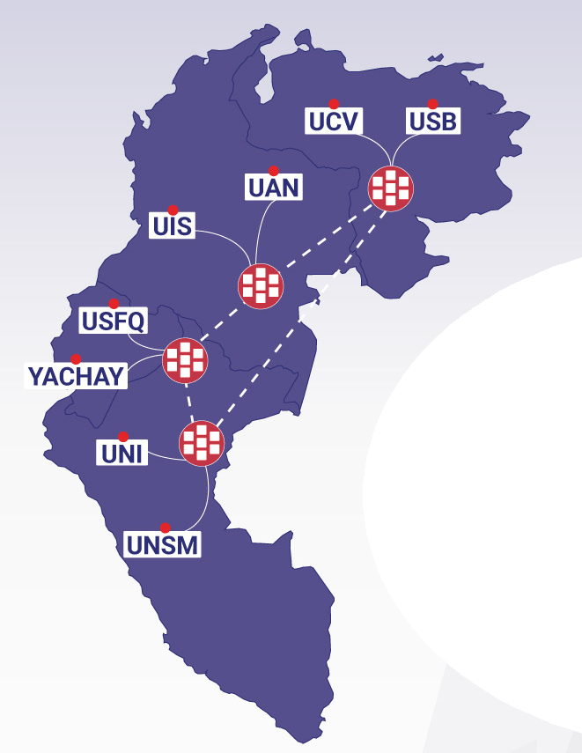
LA-CoNGA physics
4
https://laconga.redclara.net/
An Erasmus+CBHE (Capacity Building in Higher Education) project co-funded by the European Commission’s Education, Audiovisual and Culture Executive Agency
A 3-years project. Officially started in January 2020
Two semesters corresponding to M2 EU Master
Courses in Physics, Scientific Intrumetation and Data Science
Internships in research labs and Industrial partners
A learning community
11 universities from Latin America and Europe join efforts with other scientific (CERN, CNRS, DESY, ICTP, IRFU) and industrial partners to contribute to
the modernisation, accessibility and internationalisation of higher education
in Colombia, Ecuador, Perú and Venezuela

Slide 5
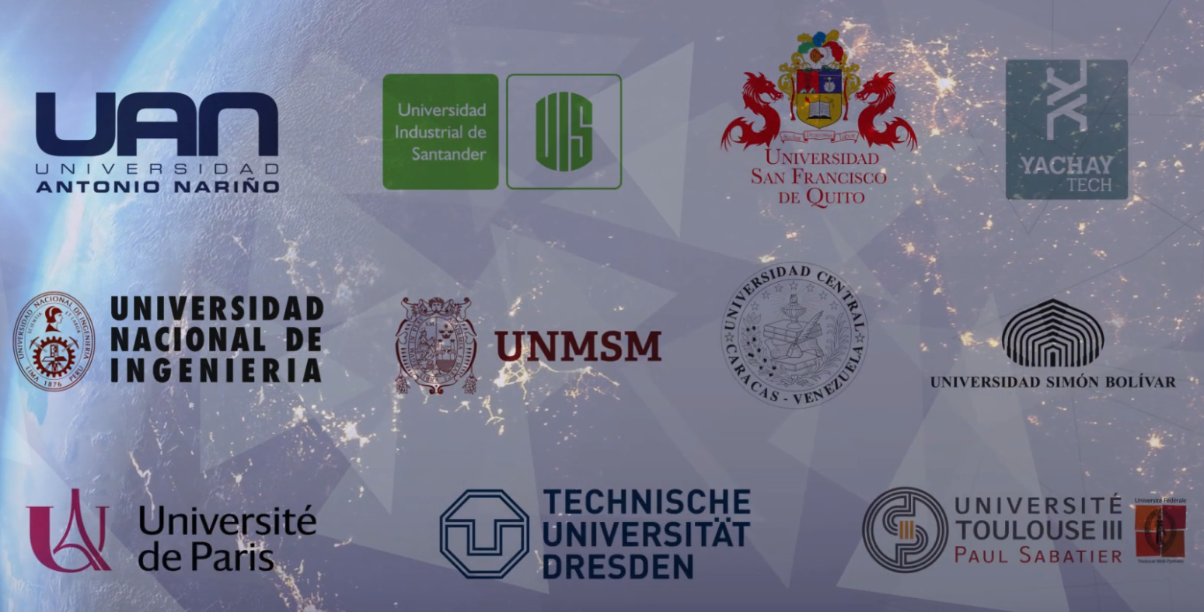
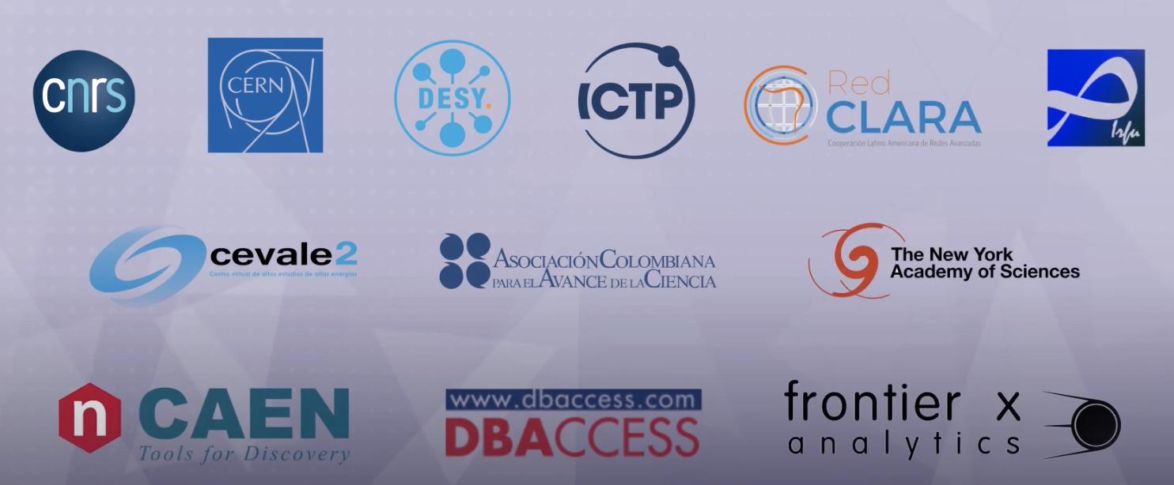
Universities and Scientific/Industrial Partners
Universities
Scientific and
Industrial partners
5

Slide 6
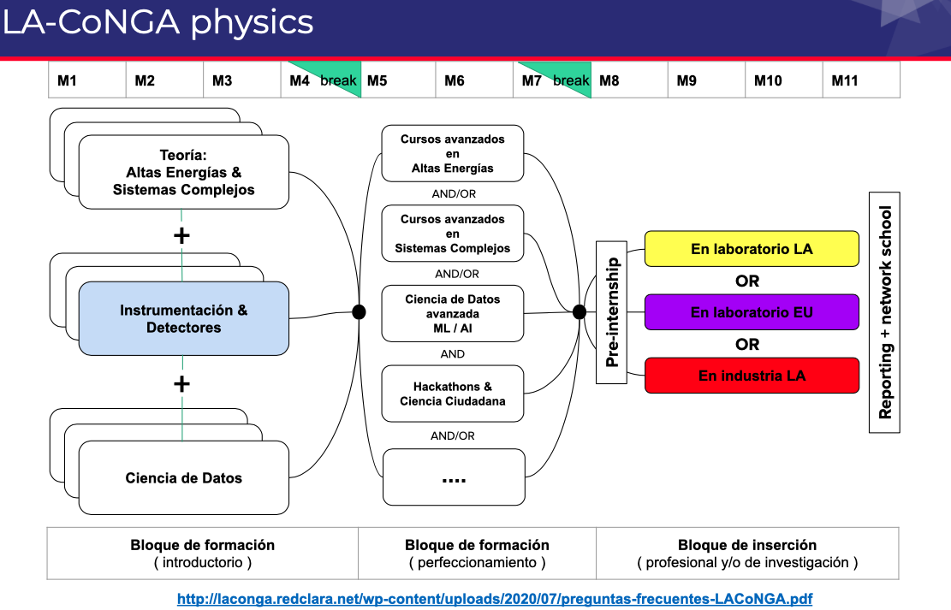
30 ECTS
10 ECTS
20 ECTS

Slide 7
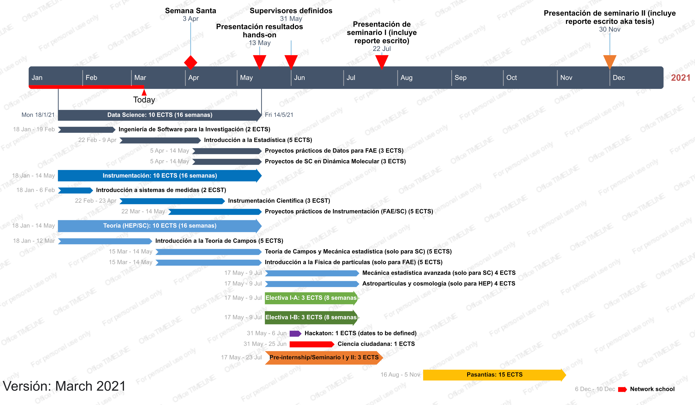
LA-CoNGA 2021 Schedule

Slide 8


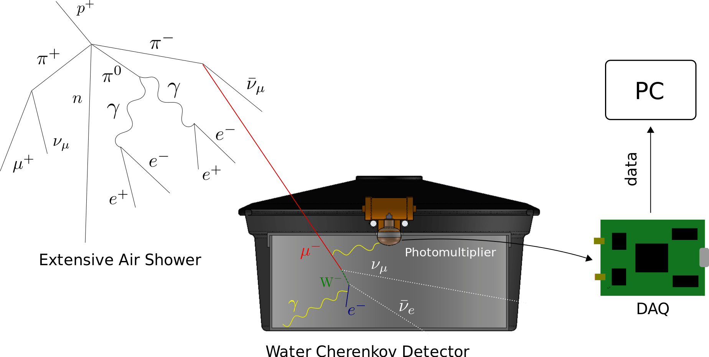
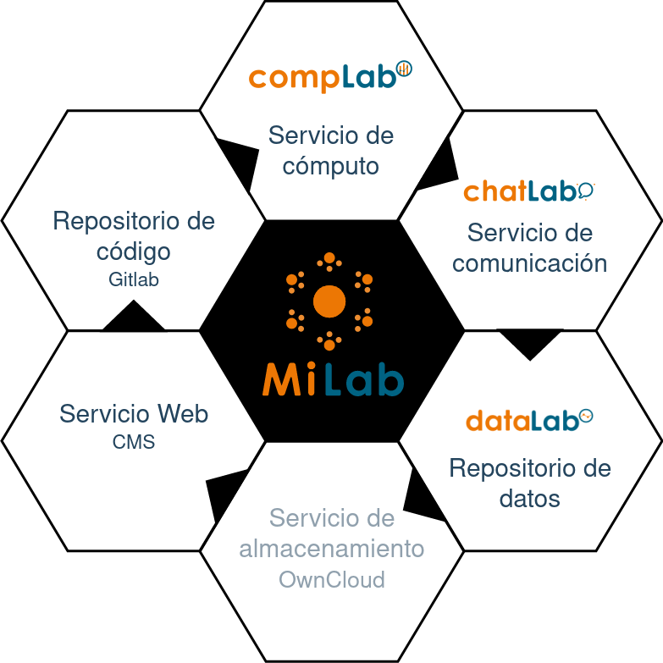






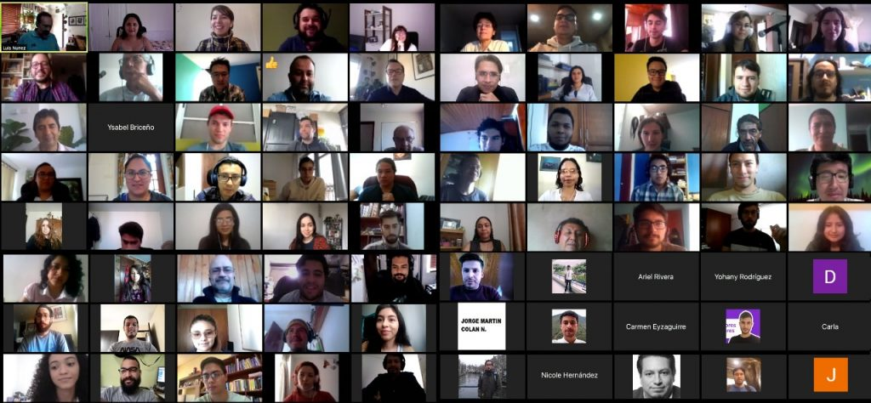



Community, Methodology and platform
An e-learning open-access platform
Good practices of scientific reproducibility
Remote-access experimental facilities
Spanish teaching material
We strengthen a sustainable, dynamic, collaborative interconnected, and diverse virtual research and learning network of Latin American and European researchers in advanced physics
With close ties to the productive sector, which leads the development of science and technology in the región
Contributing to the modernisation, accessibility and internationalisation of higher education systems in the región
Using of technology in educational environments
to enhance learning
Applying good scientific practices and gender equality
We envision similar experiences in other disciplines
Re
Documentos, Códigos
Visibilidad WEB
Gestión Grupos Inv
Conf-Lab
Organización
Eventos
Instrum-Lab
Operación remota
Instrumentos,
Realidad Virtual

Slide 9




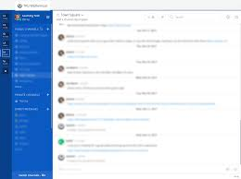




Teaching platform
Content y Access
Class n
Course 1
Repository Git
Admin
GitLab
Videos
carpetas
Text
Class 1
Class 2
Class 4
Class 5
Class 6
Class n
Data
Push/Pull
Push/Pull
IT Resources
Repository
Git Prof
Repository
Git Prof
Instruments
VideoConf
Push/Pull
Repository
Git Student
Repository
Git Student
Forums
Instant Messaging
Repository
Git Student

Slide 10


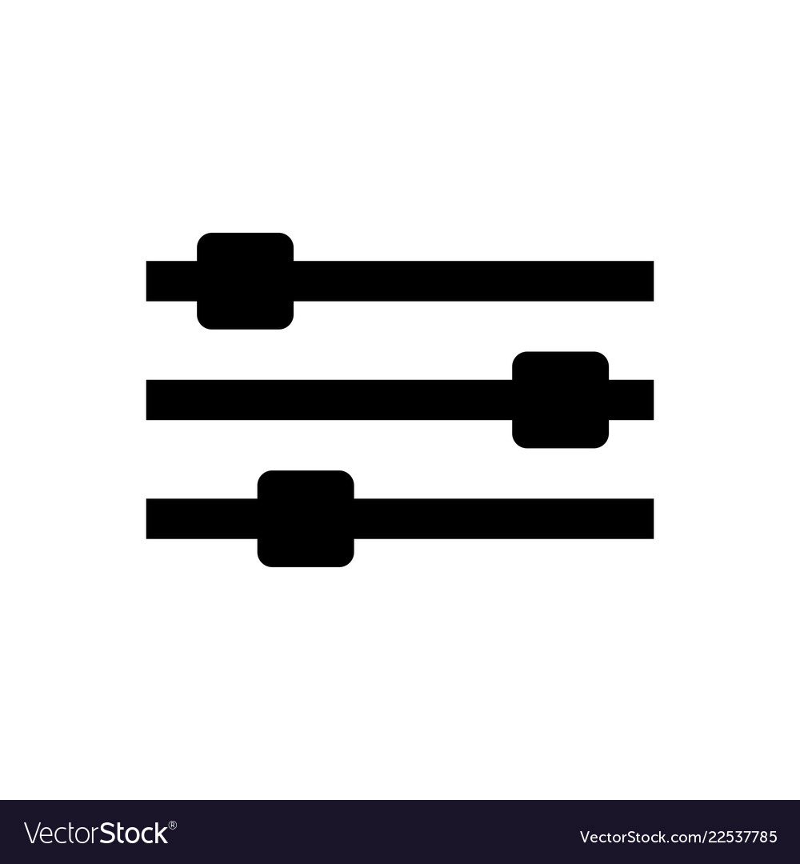
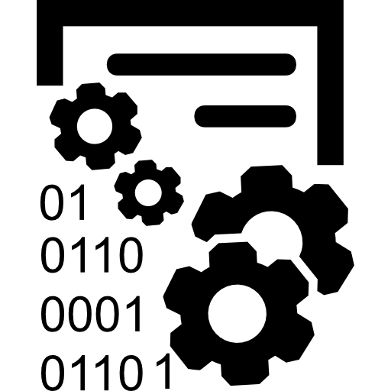

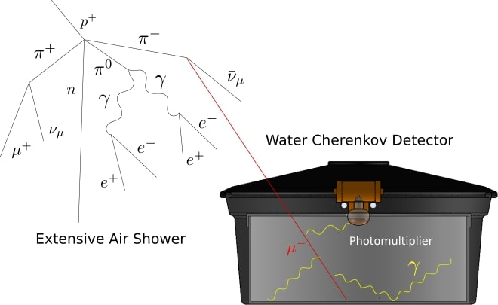
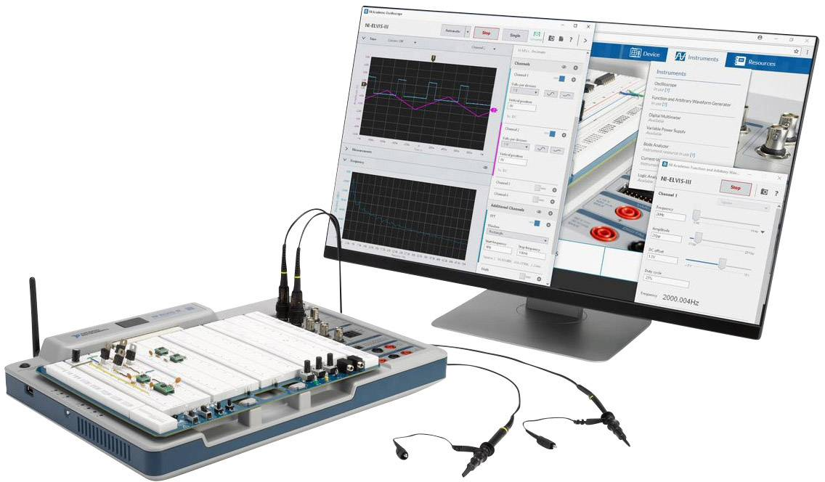
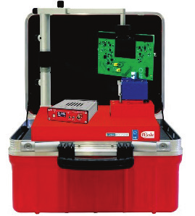
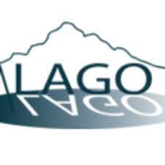
Remote-access labs
Biblio.
Demo
Control and data taking
Communication
Remote-access detectors and instruments
CAEN
National Instruments
10

Slide 11
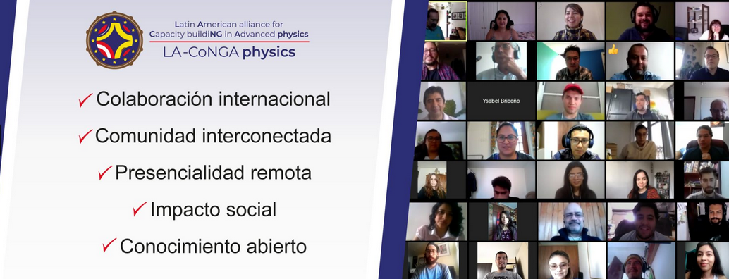
Thank you!!
2021 = 30 instructors ; 50 students in 4 countries ; 100 classes in Spanish
2022 = 70 students

Slide 12
Questions?

